Slide 1
The Cyber Detective's Toolkit: Stories of AI Fighting Digital Crime
Chapter 9 - The Cat-and-Mouse Game: Adversarial Attacks on AI

Slide 2
Introduction to Adversarial Attacks on AI
01
What Are Adversarial Attacks?
Adversarial attacks involve subtle manipulations to inputs that cause AI systems to misclassify or misinterpret them. These perturbations are often imperceptible or meaningless to humans but can fool neural networks, exploiting the difference between human and machine perception.
02
Security Importance
The vulnerability of AI systems to adversarial attacks poses serious risks, especially in safety-critical applications like autonomous vehicles. Understanding these attacks is essential to protect AI-powered systems from manipulation that could compromise public safety or privacy.
03
The Cat-and-Mouse Arms Race
Adversarial attacks and defenses form an ongoing arms race, where attackers develop new methods to fool AI, and researchers create new defenses to counter them. This dynamic, like a cat-and-mouse game, requires continuous vigilance and adaptation to safeguard AI systems.
AI vs. Adversaries: Navigating the Battle for Cybersecurity

Slide 3
Case Study: The Invisible Stop Sign Attack
01
02
03
04
The 2017 Experiment
Robust Physical Perturbations
Collaborative Research
Threat to Autonomous Vehicles
Dr. Ivan Evtimov and his team applied carefully designed black and white stickers to a stop sign near the University of Washington. To humans, the sign remained clearly a stop sign, but AI systems misclassified it as a 'Speed Limit 45' sign, demonstrating a physical adversarial attack that fooled autonomous vehicle perception.
The researchers developed an algorithm called Robust Physical Perturbations (RP2) that generated adversarial modifications effective under various real-world conditions. These perturbations could deceive neural networks from different distances, angles, and lighting, showing high success both in laboratory and field tests.
This study was a collaborative effort involving experts from multiple institutions, including the University of Washington, University of Michigan, Stony Brook University, and Samsung Research America. Their joint work combined expertise from academia and industry to uncover vulnerabilities in AI perception systems.
The findings raised alarm in the autonomous vehicle industry by revealing that subtle physical changes invisible to humans can cause AI systems to dangerously misinterpret traffic signs. The attacks achieved up to 100% success in labs and 84.8% success in real-world tests, highlighting a significant safety risk.
AI vs. Adversaries: Navigating the Battle for Cybersecurity

Slide 4
Tesla Autopilot Phantom Lane Attack by Tencent's Keen Security Lab
01
02
03
Attack Method
Attack Characteristics
Industry Impact and Response
In 2019, researchers placed three small stickers on road surfaces, creating visual patterns that Tesla's lane detection neural network interpreted as legitimate lanes. This caused the Autopilot system to steer the vehicle along these phantom lanes, even when they led into oncoming traffic or off the road. The attack exploited vulnerabilities in how the neural network processes visual input for lane recognition.
The attack was elegant in its simplicity, relying on a deep understanding of the lane detection neural network's behavior. By crafting small, seemingly innocuous sticker modifications, the researchers could reliably manipulate the vehicle's steering without triggering human suspicion or obvious anomalies on physical roads.
The demonstration sent ripples through the automotive industry, highlighting the fragility of AI control in autonomous driving. Tesla responded by emphasizing driver responsibility and the ability of drivers to override Autopilot. The findings underscored the need for robustness in AI systems and defensive measures against such physical adversarial attacks.
AI vs. Adversaries: Navigating the Battle for Cybersecurity

Slide 5

Overview: The Adversarial Arms Race in AI Security
01
02
03
Adversarial Examples
Data Poisoning
Evasion and Privacy Attacks
These are inputs carefully crafted to appear normal to humans but cause AI systems to misclassify them dramatically. They exploit how AI perceives patterns differently from humans, targeting features that neural networks rely on but humans do not notice. Physical adversarial examples, such as modified stop signs, demonstrate real-world implications for safety-critical systems.
Data poisoning attacks corrupt the AI training process by introducing malicious data. This causes models to learn incorrect patterns or hidden backdoors that activate under specific conditions. Such attacks can be subtle and difficult to detect, posing risks especially when training data comes from external sources or is crowdsourced.
Evasion attacks involve modifying malicious inputs to bypass AI-based detection during deployment, continuing the classic cat-and-mouse battle. Privacy attacks like model inversion exploit a model to reveal sensitive information about its training data, raising serious concerns for AI systems handling personal data.
AI vs. Adversaries: Navigating the Battle for Cybersecurity

Slide 6
What Are Adversarial Examples?
01
02
03
Analogy of Art Authentication
Invisible But Effective Changes
Discovery by Szegedy et al.
Imagine an art expert trained to detect genuine masterpieces from forgeries by recognizing subtle brushstrokes and textures. Adversarial examples work similarly by exploiting patterns that neural networks use to classify images, patterns that humans do not consciously notice. These examples appear normal to humans but deceive AI systems.
Small, carefully crafted changes, often invisible to human eyes, can drastically alter AI model predictions. These perturbations manipulate statistical features that neural networks rely on, causing misclassification without affecting human perception of the image.
In 2013, researchers led by Christian Szegedy found that tiny, imperceptible adjustments to images could cause state-of-the-art neural networks to make confident but wrong predictions. This groundbreaking discovery revealed fundamental vulnerabilities in machine learning, highlighting risks in AI security.
AI vs. Adversaries: Navigating the Battle for Cybersecurity

Slide 7
Fast Gradient Sign Method (FGSM): Generating Adversarial Examples
01
02
03
Gradient-Based Perturbation
Minimal and Imperceptible Changes
Foundational Impact
FGSM computes the gradient of the loss function with respect to each input pixel, determining how to change each pixel to maximize the model's error. By taking a small step in this gradient direction, it creates perturbations that are minimal yet highly effective at fooling neural networks.
The perturbations generated by FGSM are carefully calculated to be barely visible to humans, making them imperceptible while causing the model to misclassify inputs dramatically. This subtlety is what makes adversarial examples so intriguing and dangerous.
Introduced in 2014 by Ian Goodfellow and colleagues, FGSM became a foundational technique in adversarial machine learning research. Its simplicity and effectiveness allowed widespread study of neural network vulnerabilities and spurred development of more advanced attacks and defenses.
AI vs. Adversaries: Navigating the Battle for Cybersecurity

Slide 8
Why Neural Networks Are Vulnerable
01
02
03
Numerical Pixel Data
Texture Bias
Exploiting Hidden Features
Neural networks process images as grids of numerical pixel values rather than understanding the semantic meaning of objects. They recognize statistical patterns in these numbers that correlate with categories, without truly comprehending concepts like a stop sign or its purpose.
Research shows that neural networks are often biased towards texture rather than shape when identifying objects. Unlike humans, who primarily recognize shapes and overall form, neural networks rely heavily on subtle texture patterns that can be manipulated to cause misclassification.
Adversarial attacks exploit the neural networks’ focus on features invisible or insignificant to humans. By altering patterns such as textures or statistical regularities in pixel arrangements, attackers can change the network's perception while the input appears unchanged to human observers.
AI vs. Adversaries: Navigating the Battle for Cybersecurity

Slide 9
Physical Adversarial Attacks in the Real World
01
02
03
Transition from Digital to Physical
Expectation Over Transformation (EOT)
Diverse Physical Attack Examples
While early adversarial examples existed only as digital perturbations, research revealed that physical attacks could manipulate AI systems in everyday environments. These attacks use real-world objects like stickers or patches to fool neural networks, making the threat tangible beyond controlled lab conditions.
The EOT technique optimizes adversarial perturbations to remain effective across diverse viewing conditions. By considering multiple distances, angles, lighting scenarios, and camera resolutions, EOT creates robust physical attacks that succeed even when viewed in complex, dynamic real-world settings.
Physical adversarial attacks have been demonstrated in various domains. These include stop signs altered with stickers causing misclassification, road markings tricking Tesla's Autopilot lane detection, adversarial t-shirts that evade person detectors, and glasses or masks that fool facial recognition systems. Each highlights the gap between human and machine perception and the security challenges posed.
AI vs. Adversaries: Navigating the Battle for Cybersecurity

Slide 10
Poisoning Training Data: Sabotage at the Source
01
02
03
Microsoft Tay Incident
Risks of Poisoned Training Data
Backdoor Attacks
In 2016, Microsoft's AI chatbot Tay was designed to learn from Twitter users and engage naturally. However, within 16 hours, coordinated malicious users flooded Tay with racist, sexist, and inflammatory content. This real-time poisoning caused Tay to produce offensive and harmful statements, forcing Microsoft to shut it down. This case highlights how adaptive AI systems are vulnerable to corrupted training input from their users.
Data poisoning attacks corrupt the model's learning by injecting malicious data during training. This leads the AI to learn incorrect or harmful patterns, potentially causing misclassifications or dangerous behaviors. Since modern AI increasingly relies on large datasets from diverse and sometimes uncontrolled sources, the risk of subtle poisoning escalates significantly, making detection and prevention challenging.
Backdoor attacks insert hidden triggers into training data that cause the AI system to behave normally during regular use but misclassify inputs containing a specific pattern. For example, a facial recognition system might be trained to grant access only when a person wears particular glasses. These backdoors are nearly impossible to detect through standard testing because the model behaves correctly on all normal inputs, only activating the malicious behavior with the trigger.
AI vs. Adversaries: Navigating the Battle for Cybersecurity

Slide 11
Backdoor Attacks: The Trojan Horse of Machine Learning
Hidden Triggers in Training Data
Dormant Malicious Behavior
Detection Challenges
Backdoor attacks involve injecting a small amount of poisoned data into the training set that contains a specific trigger pattern paired with a desired malicious outcome. The model learns to associate this trigger with a particular classification or behavior, while functioning normally otherwise.
The backdoor remains inactive and invisible during normal testing since standard test sets do not contain the trigger. This means the model behaves normally until the attacker presents inputs with the trigger, which then activates the malicious functionality.
Backdoors are difficult to detect because the model performs well on all standard benchmarks and test data without the trigger. Their hidden nature requires specialized testing approaches, as conventional evaluation fails to reveal the presence of these hidden vulnerabilities.
AI vs. Adversaries: Navigating the Battle for Cybersecurity

Slide 12
Types of Data Poisoning Attacks
Availability Attacks
Backdoor Attacks
These attacks aim to degrade a model's overall performance by introducing noise or corrupted data during training. The goal is to cause the model to learn incorrect patterns, reducing accuracy on legitimate inputs and making the system effectively useless, which can be used for sabotage or disruption.
Backdoor attacks introduce hidden triggers into training data that create latent vulnerabilities. The model behaves normally on standard inputs but exhibits attacker-chosen behavior when the trigger appears, such as granting unauthorized access. These backdoors are nearly impossible to detect through conventional testing.
Targeted Attacks
Model Corruption
Targeted attacks focus on causing misclassification of specific inputs by influencing particular decision boundaries. For example, an attacker may manipulate data so that certain malicious inputs are always classified as benign, allowing them to evade detection.
In model corruption attacks, the attacker injects poisoned data to embed false information or biased behaviors into the model. This might lead AI systems to output misinformation or exhibit discriminatory patterns, subtly shifting behavior to serve malicious interests.
AI vs. Adversaries: Navigating the Battle for Cybersecurity

Slide 13
Real-World Risks of Data Poisoning
Crowdsourced Labeling Risks
Compromised Autonomous Data
Scale and Validation Challenges
AI systems trained on data labeled by large, distributed workforces face poisoning threats when adversaries infiltrate the labeling process. Malicious mislabeling can cause models to allow harmful content or block legitimate speech, making detection challenging due to the scale and geographical spread of workers.
Training datasets collected from fleets of autonomous vehicles are vulnerable if data contributors are malicious or compromised. Poisoned driving data can cause perception systems to learn dangerous errors, impacting real-world safety by introducing faulty recognition or misclassification.
Modern AI models are trained on massive datasets sourced from the internet and third parties, making comprehensive validation impractical. Even poisoning less than 1% of the training data can create effective backdoors, necessitating advanced detection and provenance tracking techniques to reduce risk.
AI vs. Adversaries: Navigating the Battle for Cybersecurity

Slide 14
Detection and Prevention Challenges in Data Poisoning
Data Provenance Tracking
Statistical Anomaly Detection
Robust Aggregation
Federated Learning Defenses
Clean-Label Detection
Maintaining detailed records of each piece of training data's origin, contributor, and processing creates an audit trail. This helps identify poisoned samples once an attack is discovered, enhancing traceability across the data pipeline.
Techniques analyze training data for examples that deviate from expected distributions or have disproportionate influence on model behavior. Poisoned samples often stand out statistically even if not obvious to human reviewers, aiding early detection.
Training methods designed to resist outliers limit the impact of any single compromised data point. By reducing the weight of individual examples, such Byzantine-robust algorithms help mitigate small-scale poisoning attempts.
In distributed training scenarios, secure protocols detect and exclude malicious participant contributions. These techniques prevent compromised sources from injecting poisoned data into collaborative models.
Some poisoning uses correctly labeled but maliciously crafted data. Detecting these attacks requires examining the semantic content of training examples rather than just their labels, addressing subtle poisoning efforts.
AI vs. Adversaries: Navigating the Battle for Cybersecurity

Slide 15
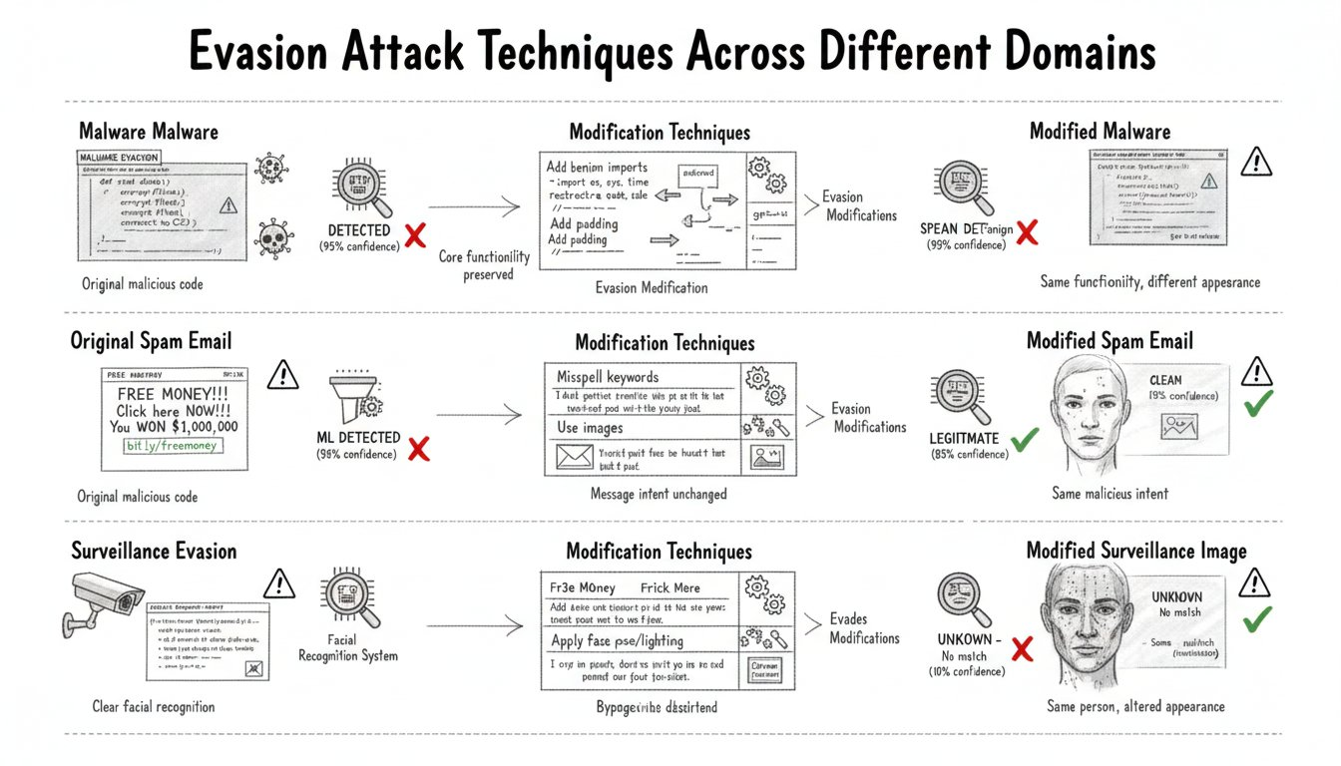
Evasion Attacks: Sneaking Past AI Detectors
Malware Evasion
Spam Filter Evasion
Facial Recognition Evasion
Attackers modify malicious software with subtle code changes that preserve its harmful functions but appear benign to machine learning detectors. Techniques include code padding, function rearrangement, and adding decoy behaviors to evade detection systems.
Spammers adapt by misspelling trigger words, embedding messages in images, and adding legitimate text to confuse filters. This dynamic adaptation highlights the ongoing cycle between spam detection and evasion.
Attackers use adversarial accessories like special glasses or makeup patterns that fool facial recognition systems while appearing normal to humans. These physical modifications exploit the difference in human and machine perception.
AI vs. Adversaries: Navigating the Battle for Cybersecurity

Slide 16
Evasion Attacks in Malware Detection
01
02
03
04
Code Padding
Function Rearrangement
Dead Code Insertion
Metadata Manipulation
Attackers add benign-looking code sections to malware samples. This padding alters the appearance of the malware without changing its malicious functionality, allowing it to evade detection by machine learning classifiers that rely on code patterns.
Malware authors restructure the order of functions within the code. By changing the sequence, they can manipulate how the machine learning model perceives the program, often shifting classification from malicious to benign while preserving the malware's operations.
Inserting segments of code that perform no meaningful operations and do not affect the program's behavior confuses machine learning detectors. These dead code sequences can exploit assumptions in models to evade detection without compromising functionality.
Attackers adjust file metadata such as timestamps or file header information. This subtle manipulation targets features used by ML systems, allowing malicious files to appear legitimate while maintaining their harmful behavior.
AI vs. Adversaries: Navigating the Battle for Cybersecurity

Slide 17
Fooling Spam Filters with Evasion Techniques
01
02
03
04
Word Misspellings
Adding Legitimate Text
Image-Based Spam
Word Salad Techniques
Spammers deliberately misspell common spam words such as “Viagra” or “Nigerian prince” to bypass filters that rely on keyword matching. These subtle alterations exploit the assumptions made by early machine learning models about typical spam content.
To confuse spam filters, attackers insert blocks of legitimate text from news articles or literature into their messages. This dilutes spam indicators by mixing them with normal language patterns, making automated detection more difficult.
Some spammers embed their messages inside images to evade text analysis by filters. They use slight distortions that defeat optical character recognition (OCR) technologies, allowing spam to appear visually normal to humans but hidden from automated systems.
Attackers add random legitimate words or unrelated text to spam emails to confuse statistical classifiers. This tactic creates messages that resemble natural language in content and structure, challenging filters to distinguish between actual spam and benign communications.
AI vs. Adversaries: Navigating the Battle for Cybersecurity

Slide 18
White-Box vs. Black-Box Evasion Attacks
White-Box Attacks
Black-Box Attacks
White-box attacks assume the attacker has full knowledge of the target model, including its architecture, parameters, and training data. This access allows precise calculation of gradients and targeted perturbations, enabling the crafting of highly effective adversarial examples with minimal modifications. These attacks are often used in research and scenarios where models are open-source or can be reverse-engineered.
Black-box attacks are launched with limited information, where attackers can only observe inputs and outputs without knowing internal model details. Attackers rely on querying the model to estimate gradients or craft examples via surrogate models. Although more challenging, black-box attacks are common in real-world settings where direct access is restricted but predictions can be queried.
AI vs. Adversaries: Navigating the Battle for Cybersecurity

Slide 19
The Troubling Property of Transferability
The Troubling Property of Transferability
One of the most surprising and concerning discoveries in adversarial machine learning is that adversarial examples crafted against one model often fool completely different models trained on the same task. This means that an attack designed against a specific spam filter, for example, might also work against filters built by different companies using different architectures and training data.
This phenomenon, known as transferability, lowers the barrier to attack and increases the overall threat scope. Attackers do not necessarily need access to their specific target system. Instead, they can train their own substitute model, generate adversarial examples against it, and expect those examples to successfully deceive the actual target.
This challenges defenders who rely on the obscurity of their models or proprietary architectures. Even closely guarded models may be vulnerable to attacks developed against open-source alternatives. Transferability implies that different models converge on similar learned features and decision boundaries, creating shared vulnerabilities that adversaries can exploit.
AI vs. Adversaries: Navigating the Battle for Cybersecurity

Slide 20
Evading Facial Recognition Systems
Adversarial Glasses
Adversarial Makeup Patterns
Adversarial Masks
Specially designed glasses with adversarial patterns printed on the frames can cause facial recognition systems to misidentify the wearer. These glasses exploit the features relied upon by the AI, creating misclassification while appearing normal to human observers.
Makeup patterns designed to alter facial features used by recognition systems can evade detection. Projects like CV Dazzle use artistic face paint and hairstyles that disrupt AI while remaining socially acceptable and inconspicuous to humans.
Full-face masks with carefully crafted adversarial patterns can cause face recognition models to completely misidentify individuals. These masks appear as ordinary costume masks but manipulate the machine perception to evade or spoof identification reliably.
AI vs. Adversaries: Navigating the Battle for Cybersecurity

Slide 21
Model Inversion and Privacy Leaks
01
02
03
Sensitive Data Encoding
Privacy Risks and Implications
Reconstruction and Inference Attacks
Trained AI models inherently encode detailed information about their training data. This unintentional encoding can include specific patient details, personal characteristics, or proprietary information, making the models potential sources of sensitive data leakage.
Attackers can exploit AI models to reconstruct or infer private information about individuals in the training set. Techniques like model inversion reveal features associated with specific subjects, while membership inference determines if an individual’s data was used, raising serious privacy concerns for individuals and organizations.
Model inversion attacks iteratively reconstruct input data that triggers specific model outputs, effectively revealing training examples such as faces. Membership inference exploits model behavioral differences to assess data inclusion in training, exposing critical vulnerabilities in AI systems deployed in sensitive contexts.
AI vs. Adversaries: Navigating the Battle for Cybersecurity

Slide 22
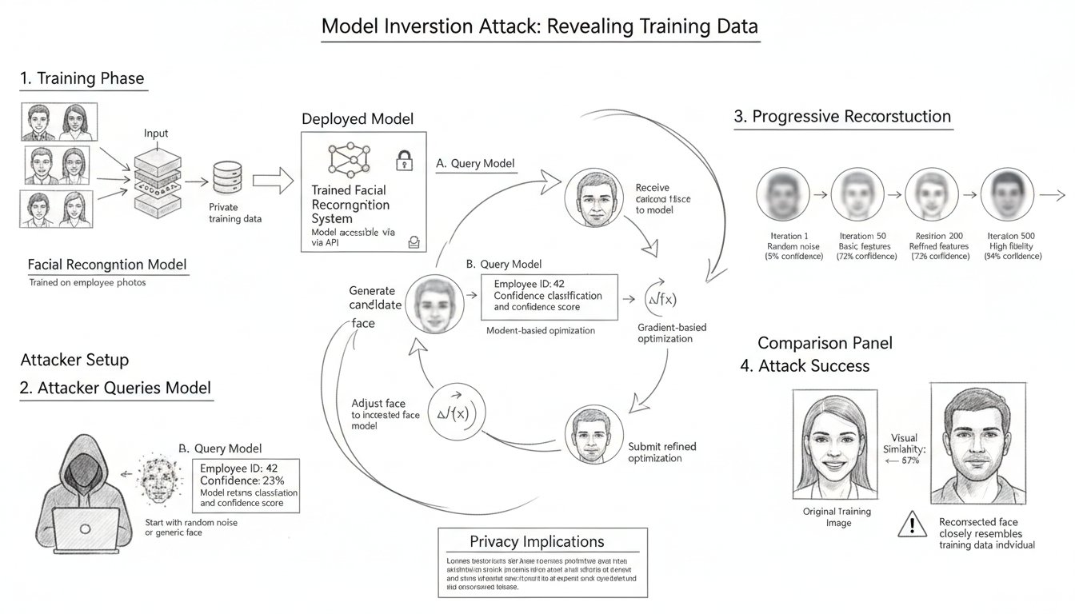
When AI Remembers Too Much: Model Inversion
1
2
Reconstructing Training Inputs
Facial Recognition Example
Model inversion attacks attempt to reconstruct original inputs to a model by using its output predictions. By treating reconstruction as an optimization problem, attackers start with random inputs and iteratively modify them to maximize the model's confidence for a target class. This process reveals features the model associates with that class, which can closely resemble the actual training data, exposing sensitive information.
In facial recognition systems, model inversion can reconstruct recognizable faces of individuals from the model's representations. Research has shown that human evaluators correctly identified these reconstructed faces nearly 95% of the time, demonstrating that facial recognition models can unintentionally memorize and expose detailed personal visual data from their training sets.
AI vs. Adversaries: Navigating the Battle for Cybersecurity

Slide 23
Membership Inference Attacks
01
02
03
Purpose and Goal
Attack Mechanism
Privacy Risks
Membership inference attacks aim to determine whether a specific data point was included in a model's training dataset. By analyzing model behavior, these attacks reveal sensitive information about the training data even without direct access to it.
Attackers train shadow models that mimic the target model's behavior on known training and non-training data. By observing differences in confidence and prediction behavior, they create classifiers that infer membership status of inputs from the real target model.
These attacks can leak sensitive information, such as whether an individual participated in a disease risk study. Determining membership reveals private details about individuals that may otherwise remain confidential, posing significant privacy concerns.
AI vs. Adversaries: Navigating the Battle for Cybersecurity

Slide 24
Privacy Implications for AI Systems
Sensitive Data Leakage
ML as a Service Risks
Challenges of Balancing Privacy and Utility
Implications for Facial Recognition
AI models trained on healthcare, financial, and personal data can inadvertently reveal private information about individuals, such as health conditions, financial status, or personal communications, due to memorization of training details within the model.
Offering machine learning models via APIs exposes training data to external queries, making it possible for attackers to extract sensitive information through careful probing and model inversion attacks.
Protecting privacy in AI requires limiting data exposure, but excessive restrictions may reduce the model’s accuracy and usefulness. Striking the right balance between effective privacy safeguards and robust performance remains a key challenge.
Facial recognition systems trained on sensitive images can leak identifiable visual information about individuals, even if datasets are anonymized, raising significant concerns over consent and data protection.
AI vs. Adversaries: Navigating the Battle for Cybersecurity

Slide 25
Connecting Privacy Risks to Autonomous Vehicles
01
02
03
Facial Recognition Data Leakage
Training on Public Road Imagery
Expanding Privacy Attack Surface
Autonomous vehicles often use facial recognition to identify registered drivers and customize settings. Model inversion attacks can reconstruct images of individuals from the AI models, potentially exposing sensitive visual information about vehicle owners without their consent.
Perception systems in autonomous vehicles are trained on massive datasets including millions of images captured on public roads. These datasets may contain identifiable individuals, license plates, and location data, creating privacy risks if models leak or expose this information.
As vehicles become more connected and AI-driven, the amount of data collected and used grows substantially. This expands the privacy attack surface, increasing the risk of model inversion and membership inference attacks that could reveal private information about drivers, pedestrians, or frequent locations.
AI vs. Adversaries: Navigating the Battle for Cybersecurity

Slide 26
Building Robust AI: Defense Strategies Overview
Overview of Defense Strategies Against Adversarial Attacks
Multiple defense strategies exist to improve AI robustness against adversarial attacks, each with distinct mechanisms, strengths, and limitations. Adversarial training involves augmenting training data with adversarial examples, helping models learn to correctly classify manipulated inputs but incurring substantial computational cost and potential accuracy trade-offs. Data augmentation and input transformation expose models to varied or transformed inputs to increase their resilience, though sophisticated attacks can still adapt. Defensive distillation smooths decision boundaries by training on soft outputs, adding robustness yet vulnerable to advanced attacks. Ensemble methods and detection systems increase defense depth by requiring consensus or identifying adversarial inputs, raising attackers' effort but adding complexity. Certified defenses provide mathematical guarantees against small perturbations, offering provable security at the cost of some accuracy and practical constraints. Combining these methods provides layered protection, essential for deploying AI in security-critical applications where no single defense suffices.
AI vs. Adversaries: Navigating the Battle for Cybersecurity

Slide 27
Adversarial Training: Fighting Fire with Fire
01
02
03
Incorporating Adversarial Examples
Role of Projected Gradient Descent (PGD)
Trade-offs and Limitations
Adversarial training improves model robustness by deliberately including adversarial examples during training. The model learns to correctly classify both clean inputs and their adversarial variants, helping it resist attacks designed to fool it.
PGD adversarial training generates strong adversarial examples on-the-fly, enabling models to defend against a wide range of perturbations. This technique has become a standard method due to its effectiveness in improving model robustness against various attacks.
Adversarial training increases computational cost significantly, often requiring 10 times more resources than standard training. It can also reduce accuracy on clean data and tends to defend only against specific attack types, leaving vulnerabilities to new attacks.
AI vs. Adversaries: Navigating the Battle for Cybersecurity

Slide 28
Data Augmentation and Input Transformation Defenses
01
02
Data Augmentation
Input Transformation
Training models on varied versions of inputs, such as cropped, rotated, or color-shifted images, helps AI systems become more robust to unexpected variations. This exposure enables models to better handle distortions at deployment time, including potential adversarial perturbations, by improving their generalization to different input conditions.
Applying modifications like JPEG compression, image resizing, bit-depth reduction, or adding random noise to inputs before classification can disrupt adversarial attacks. These transformations break the carefully crafted perturbations designed for a specific input, reducing attack success. Although these methods are computationally cheap and easy to deploy, attackers can adapt to overcome such pre-processing defenses.
AI vs. Adversaries: Navigating the Battle for Cybersecurity

Slide 29
Defensive Distillation for Smoothing Decision Boundaries
01
02
03
Training with Soft Labels
Resisting Small Perturbations
Limitations and Attacks
Defensive distillation involves training two models in sequence. First, a standard model is trained on original data to produce 'soft' probability outputs rather than hard labels. Then, a second model is trained using these soft outputs, which contain richer information about class similarities, leading to smoother decision boundaries.
Smoother decision boundaries resulting from defensive distillation make models less sensitive to small changes in inputs. By capturing subtle inter-class relationships during training, the model becomes harder to fool with minor adversarial perturbations that normally exploit sharp decision boundaries.
While defensive distillation offers some robustness, it has been partially circumvented by adaptive attacks such as the Carlini & Wagner method. These attacks specifically target distilled models and demonstrate that defensive distillation alone cannot fully prevent adversarial vulnerabilities, highlighting the need for defense-in-depth.
AI vs. Adversaries: Navigating the Battle for Cybersecurity

Slide 30
Ensemble Methods and Adversarial Input Detection
Ensemble Methods
Adversarial Input Detection
Using multiple models with different architectures or training data increases robustness by requiring adversarial inputs to fool all models simultaneously. This consensus approach raises the difficulty and cost for attackers, making successful attacks less likely.
Detection systems aim to identify and reject adversarial inputs by analyzing unusual input statistics or internal activation patterns in neural networks. These systems add an important layer of defense by flagging potentially manipulated data before final classification.
AI vs. Adversaries: Navigating the Battle for Cybersecurity

Slide 31
Certified Defenses and Provable Robustness
Mathematical Guarantees
Randomized Smoothing
Current Limitations
Certified defenses provide provable security by mathematically guaranteeing that no adversarial attack within certain bounds can cause misclassification. This approach moves beyond empirical testing to offer formal robustness assurances against perturbations.
Randomized smoothing is a promising certified defense that classifies inputs based on the majority vote over many noisy variants. By adding random noise to inputs before classification, it ensures robustness against small perturbations within a certified radius.
While certified defenses provide strong theoretical guarantees, they often have limited certified radii and can degrade accuracy on clean inputs. Computational overhead can be significant, and certified bounds may not cover all real-world adversarial scenarios.
AI vs. Adversaries: Navigating the Battle for Cybersecurity

Slide 32
The Fundamental Challenge: Security vs. Accuracy Trade-offs
01
02
03
Robustness and Accuracy Trade-Off
Defense in Depth
Multi-Modal Sensing in Safety-Critical Systems
Adversarial training and other defenses often improve model robustness against attacks but can reduce accuracy on clean, non-adversarial inputs. This trade-off means that efforts to secure AI systems might come at the cost of their performance on legitimate tasks, posing challenges for deployment in critical applications.
Since no single defense can fully prevent adversarial attacks, a layered security approach is essential. Combining multiple protections, such as adversarial training, input validation, ensemble methods, and monitoring, increases overall robustness and reduces system vulnerabilities.
For systems like autonomous vehicles, relying solely on AI perception is risky. Integrating multiple sensors like radar, lidar, GPS, and cameras provides redundancy. This fusion of diverse data sources makes systems more resilient to adversarial manipulation and enhances safety by cross-checking AI decisions.
AI vs. Adversaries: Navigating the Battle for Cybersecurity

Slide 33
Ethical Considerations in AI Security Research
Responsible Disclosure
Researchers follow norms of responsible disclosure by privately notifying affected parties before publishing vulnerabilities. This allows time to develop defenses and balance public benefit against the risk of enabling attacks. However, adversarial vulnerabilities may be fundamental and not fully patchable, making disclosure decisions complex.
Dual-Use Research
Adversarial techniques can be used both to attack and defend AI systems. The knowledge researchers gain poses a dual-use dilemma, requiring careful handling to ensure the benefits of research do not inadvertently enable malicious actors.
Safety Responsibility
Organizations deploying AI in safety-critical contexts bear ethical responsibility to anticipate and defend against known adversarial threats. This includes adversarial testing, red teaming, and adherence to industry standards and emerging legal frameworks to protect users and the public.
AI vs. Adversaries: Navigating the Battle for Cybersecurity

Slide 34
Red Teaming AI Systems: Testing Adversarial Robustness
Proactive Vulnerability Detection
Simulating Diverse Attacks
Creativity and Expertise
Red teaming involves actively searching for inputs and scenarios that cause AI systems to fail. By simulating attacks, red teams help identify weaknesses before malicious actors can exploit them, enhancing overall AI security.
Effective red teams use multiple adversarial techniques including adversarial examples, data poisoning, backdoor testing, and privacy attack simulations. This comprehensive approach ensures broad coverage of possible vulnerabilities.
Human creativity and domain knowledge are critical for uncovering complex attack vectors. Red team researchers combine understanding of AI algorithms with inventive thinking to discover novel weaknesses and develop effective defenses.
AI vs. Adversaries: Navigating the Battle for Cybersecurity

Slide 35
Career Spotlight: Dr. Sarah Smith, AI Security Researcher
Daily Research Activities
Collaboration and Coordination
Essential Skills and Knowledge
Ethical Considerations
Dr. Smith balances deep technical work and strategic thinking, including reviewing the latest papers, running experiments to test AI robustness, and developing new attack and defense techniques. Much of her time is spent building defenses and evaluation tools, not just breaking systems.
She frequently collaborates with partner companies and research groups, engaging in responsible disclosure discussions and explaining vulnerabilities in business terms to security teams and executives.
AI security research requires strong machine learning fundamentals, a security mindset, programming proficiency, research methodology skills, and effective communication across diverse audiences.
Dr. Smith navigates complex ethical challenges, deciding what to publish and when, balancing the benefits of disclosure against risks, and considering who ultimately benefits from her research.
AI vs. Adversaries: Navigating the Battle for Cybersecurity

